Slide 1
An introduction to SEM in R
Dr Sarah Gardner
Sarah.gardner@ntu.ac.uk

Slide 2

About Me
Sarah Gardner (Senior Lecturer, Nottingham Trent University)
Research: Social development: bullying, friendship, social networks, emotion regulation. Cyberpsychology - cyberhate, online risk, attitudes towards AI.
Methodology: SEM-type analyses, Social Network Analysis
Teaching: statistics (Level 4 to PhD+), quantitative research methodology (psychometrics), (social) developmental psychology.
Frogatt Edge, Derbyshire

Slide 3
Today’s Session
Starting point to using R for SEM analyses
We will be trying to fit a lot into 5 hours (usually we would cover this content over 3 days!)
Things may move quickly so you may need to revisit the content after
Focus on implementing in R rather than statistical theory

Slide 4
Session Content Overview
Measurement Models:
Confirmatory Factor Analysis in R
Structural Models
Simple mediation
Serial and parallel mediation
Moderation
Moderated mediation (if time)

Slide 5
Plan for Today (10am – 4pm)
10am – 11am: Introductions and quick SEM concept re-cap
11am – 12:00: Introduction to lavaan and CFA in R
12:00 – 12:45: LUNCH
12:45 – 14:30: Mediation (including serial and parallel)
14:30 – 16:00: Moderation (and if time – moderated mediation)
Where possible will try and fit in smaller breaks as well.

Slide 6
Materials

Slide 7
What is structural equation modelling (SEM)?
A very quick re-cap!

Slide 8
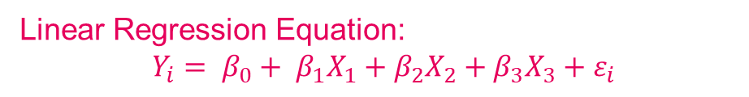
Path diagram for linear regression:
How do we measure
depression?
How do we measure
our predictor variables
in this model?
Age
Depression
Sex*
Birth Order
* Here I'm referring to biological sex (the discussion around how to best measure gender is a worthy one, however)
Linear Regression Equation:
$$Y_{i}= β_{0}+ β_{1}X_{1}+β_{2}X_{2}+β_{3}X_{3}+ε_{i}$$

Slide 9
How do we measure ‘unobservable’ constructs?
Becks Depression Inventory
Feel sad
Discouraged about future
Depression
Loss of interest
More tearful
An individual’s value on the latent variable “causes” them to respond to the observed items in a particular way
Etc.

Slide 10
Latent Variables
Latent variables are sometime referred to as “theoretical” or “hypothetical” variables. They may also be referred to as a “construct”.
These labels highlight the theoretical context in which latent variables are embedded.
Latent variables as a way to reduce complexity in a set of data
Summarises a set of indicators (items/questions)
Address limitations of relying on single indicators

Slide 11
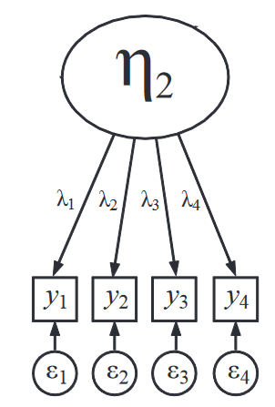
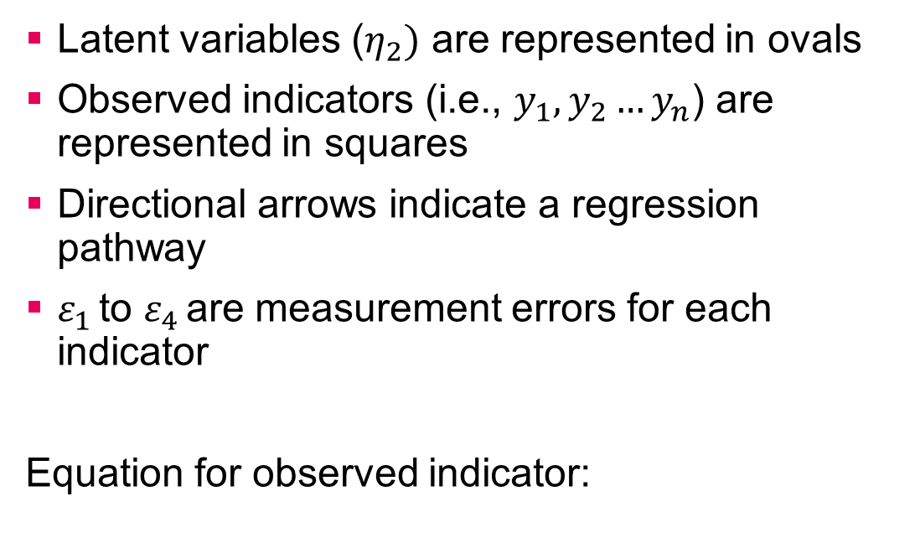
Latent Variable (graphical)
Latent variables ($η_{2})$ are represented in ovals
Observed indicators (i.e., $y_{1}, y_{2}…y_{n}$) are represented in squares
Directional arrows indicate a regression pathway
$ε_{1 }$to $ε_{4 }$are measurement errors for each indicator
Equation for observed indicator:
$$y_{1}= α_{1}+ λ_{1}η_{2}+ ε_{1}$$

Slide 12
Latent Variables – Estimation
A tool for analysing a correlation or covariance
matrix of observed variables to identify smaller
number of factors/groups/components
How do estimate (measure) latent variables in statistics?
One common tool – Factor Analysis
Exploratory
Confirmatory
Often used within SEM

Slide 13
Confirmatory Factor Analysis (CFA)
CFA, like EFA, aims to model observed relationships amongst a set of indicators with a smaller set of latent variables.
However, unlike EFA, the researcher specifies the number of factors (latent variables) and which indicators (observed variables) load onto which factors – in advance.
CFA requires strong empirical and/or conceptual foundation to guide the specification of the model.
Focus on theory testing

Slide 14
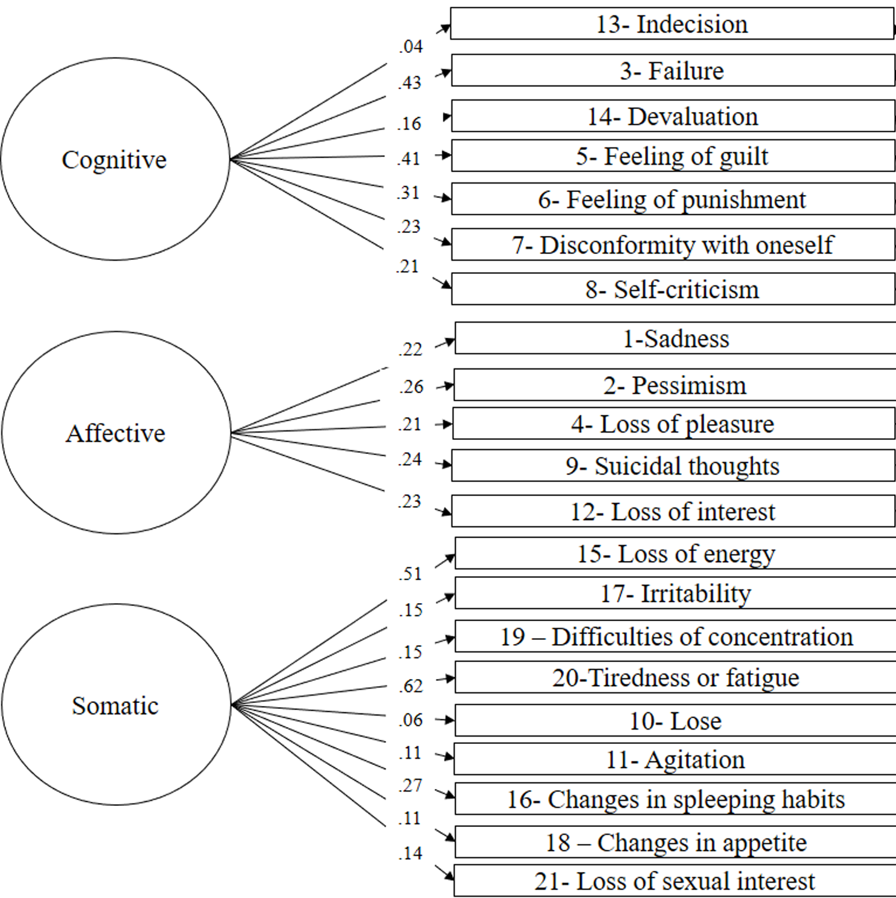
Beck’s Depression Inventory
Here we have three latent factors
(cognitive, affective, somatic)
and 21 observed items

Slide 15
CFA (and subsequently SEM)– Some benefits
When using CFA we are given an “evaluation” of how well the solution reproduces the sample covariance matrix of the measured variables
This known as model fit e.g., Chi-square value, CFI, TLI, RMSEA etc.
Rules of thumb… (not ideal): https://easystats.github.io/effectsize/reference/interpret_gfi.html#indices-of-fit
CFA accounts for measurement error
In some instances we may choose to covary this measurement error (e.g., similarly worded items, observer ratings etc.)
CFA is an excellent tool for construct validation e.g., convergent validity, discriminant validity, equivalence of measurement model across different distinct groups

Slide 16
What is SEM?
So far we have discussed one part of SEM…CFA – this is known as the measurement model
We may have multiple measurement models i.e., depression and stress – and we may want to look at how those two constructs (latent variables) are related. For example, does stress predict depression? This is known as the structural model
“Full” Structural Equation Modelling = measurement model + structural model

Slide 17
SEM – Full Structural Model
Observed
Observed
Stress
Depression
Observed
Observed
Observed
Observed
IV (exogenous latent variable)
DV (endogenous latent variable)
Note: Here I have specified depression as one latent variable for simplicity

Slide 18
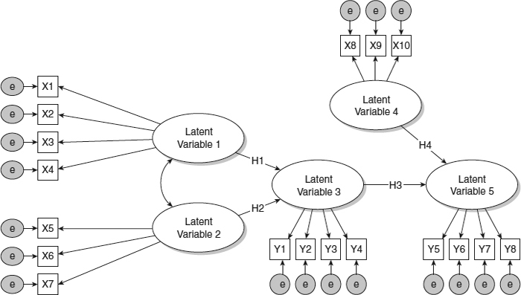
More complex models…
Single headed arrows represent regression path (usually linear if between two latent variables), i.e., y = a + bx
Double headed here refers to covariance/correlation

Slide 19
SEM
Structural equation modelling can be broken down into two parts
Part 1: The measurement model (CFA)
Here we are specifying how latent variables are measured i.e., via observed indicators (usually questions/items in a scale)
Part 2: The structural model
Here we specify the relationships between the independent and dependent variables. These may be latent variables, but could also be observed variables e.g., age, sex

Slide 20
Path Analysis
We can specify models without latent variables – this is sometimes referred to as path analysis
Self-efficacy
Social Support
Life Satisfaction
Social Connectedness

Slide 21
SEM in R
Lots of different packages developed over last few years
Lavaan is currently the most advanced and well-developed package for SEM modelling.
Regularly updated and has a good online following
Yves Rosseel (2012). lavaan: An R Package for Structural Equation Modeling. Journal of Statistical Software, 48(2), 1-36. URL http://www.jstatsoft.org/v48/i02/

Slide 22
Lavaan Steps
Step 1: Outline your statistical model
Tell R/lavaan how latent variables are measured, the relationship between variables and define any parameters (if necessary).
Tip: Draw your model out first on a piece of paper/computer. Visualising your models can help reduce errors.
Step 2: Run your statistical model on your data
Tell R/lavaan how you want the model to be run i.e., what estimator (e.g., ML, MLR, WLSMV etc.), how to deal with missing data, bootstrap estimates etc.
Step 3: Request model output summary
Optional extras – request model fit statistics, standardized estimates, confidence intervals etc.

Slide 23
Lavaan – Key Syntax
Lavaan syntax is based off Mplus syntax
We use this syntax to specify our model
Formula type | operator | mnemonic | Example
Latent variable definition | =~ | Is measured by | latent_y =~ item1 + item2 + item3
Regression | ~ | Is regressed on | y ~ x1 + x2 + x3
Residual co(variance) | ~~ | Is correlated/covaried with | item1 ~~ item2
Intercept | ~ 1 | Intercept | item1 ~ 1
Define parameter | := | Is defined by | indirect_effect := a*b
Label parameter | * |  | y ~ a*x1 + b*x2 + c*x3
https://lavaan.ugent.be/tutorial/syntax1.html

Slide 24
Practical 1 – CFA (measurement model)
We will be running a CFA on the CES-D 8 scale using data from the European Social Survey Wave 6. This is an 8-item measure of depression.
Item 4 (you were happy) and item 6 (you enjoyed life) are reverse coded
Open RStudio and the cfa.r script from within the folder SHU Training Day 3
D1
D2
D3
Depression
D4R
D5
D6R
D7
D8

Slide 25
Activity 1
D1
Have a go at running a CFA with two factors measuring depression.
D2
Negative Affect
D3
D5
D7
Positive Affect
D8
D6R
D4R

Slide 26
Covary error terms
D1
We can covary error terms in our measurement model using ~~
e.g., D4R ~~ D6R
D2
D3
Depression
D4R
D5
D6R
D7
D8

Slide 27
Mediation in R

Slide 28
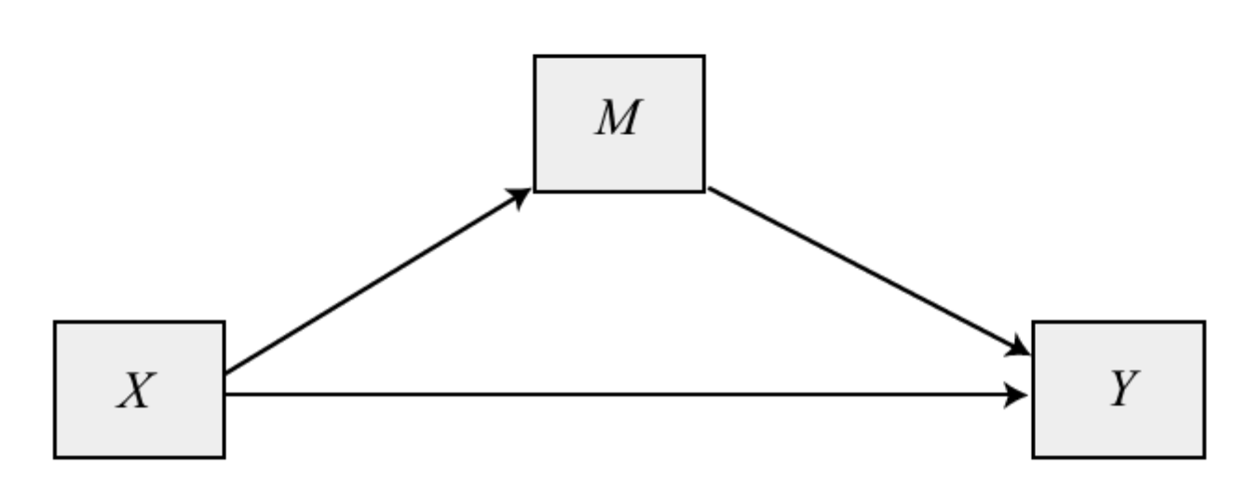
What is mediation?
Mediation helps us understand the how and why underlying a relationship.
Mediation is when predictor X has an effect on outcome Y via mediating variable, M.
e.g.,
Attitudes to smoking (X) predicts intention to smoke (M), which predicts smoking behaviour (Y)
Does parental investment (M) serve as a mechanism in the association between socioeconomic status (X) and cognitive skill development (Y)?

Slide 29
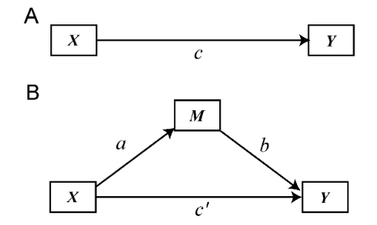
Direct, indirect effects & total effects
In mediation we talk about direct effects, indirect effects and total effects.
The indirect effect is the effect of X on Y via the mediator (a x b)
The direct effect is the remaining effect of X on Y (c’)
Total Effect (c) = indirect effect (ab) + direct effect (c’)

Slide 30
Testing for the Indirect Effect
There are different ways to test for the indirect effect. The current recommended way is via a bootstrapped estimate of the confidence intervals of the indirect effect (a*b)
If 0 is contained within that confidence interval then we evidence for our indirect effect.

Slide 31
Indirect Effects in R (lavaan)
model <- '
#measurement model
outcome =~ item1 + item2 + item3
mediator =~ item4 + item5 + item6
predictor =~ item7 + item8 + item9
#structural model
outcome ~ b*mediator + c*predictor
mediator ~ a*predictor
#define new parameters
ind := a*b
total := c + ind
'
We will ask R to calculate the a x b estimate by naming our parameters and defining a new parameter.
This is done when specifying our model
We name parameters using the * option.
New parameters are specified using the := option

Slide 32
Practical 2
Using the European Social Survey Wave 6 data again
Depression will be specify as a latent variable
Optimism and trust in people as observed.
We will test the hypothesis:
There is an indirect effect between optimism and depression via trust in people.
Open up the script mediation.r
Trust in People
a1
b1
Depression
Optimism
c’

Slide 33
Activity 2
Trust in People
a1
b1
Depression
Optimism
c’
a2
Trust in Politics
b2

Slide 34
Demo: Serial Mediation
Trust in People
d1
Trust in Politics
b2
a1
a2
b1
Depression
Optimism
c’

Slide 35
Moderation in R

Slide 36
Moderation
Model Diagram:
Moderator
When talking about ‘moderation’ or ‘interaction’ effects we hypothesise that the strength and/or sign of the relationship(s) between two variables differs according to the levels of one or more moderators.
Where mediation focuses on the “why” or “how”, moderation helps us answer “when” or for “whom”.
X
Y
Statistical Diagram:
b1
X
b2
Moderator
b3
Y
X*Moderator

Slide 37
Moderation – Binary Moderator
Outcome
Moderator = 1
Slope = B1 + B3
Slope = B1
B2
Moderator = 0
Predictor
$$Outcome= β_{0}+ β_{1}Predictor+β_{2}Moderator +β_{3}(Predictor∗Moderator)$$

Slide 38
Moderation – Continuous Moderator
Outcome
Moderator = Chosen value of moderator (W)
Slope = B1 + B3XW
Line where slope = 0
Predictor
Simple slopes test

Slide 39
Moderation - Simple Slopes
A simple slope is the regression of the outcome Y on the predictor X, at a specific value of the moderator W.
The value(s) of W are chosen by the user
For continuous interactions, it is common to use -1SD, mean, +1SD – but many other options are also used (e.g., John-Neyman method).
Values should still be theoretically meaningful.

Slide 40
Moderation Example
Math
Does the relationship between social studies (X) and reading (Y) depend on maths ability (W)?
We will calculate three simple slopes
-1SD below = b1 + b3*(mean – SD)
mean = b1 + b3*(mean)
+SD above = b1 + b3*(mean + SD)
Social
Reading
Statistical Diagram:
b1
Social
b2
Math
b3
Reading
Social*Math

Slide 41
Lavaan – Obtaining Mean and Variance
model <- ‘
#regressions
outcome ~ predictor
outcome ~ moderator
outcome ~ interactionterm
#define mean label
moderator ~ mean*1
#define variance label
moderator ~~ variance*moderator
#simple slopes parameters
SDbelow := b1 + b3*(mean – sqrt(variance))
mean = b1 + b3*(mean)
Sdabove = b1 + b3*(mean – sqrt(variance))
In lavaan we can label the mean and variance parameters so we can use these in our simple slopes equations.

Slide 42
Demo: Moderation in Lavaan (observed variables)
Does the relationship between reading performance (Y) and social studies scores depend on maths ability (W)?
This dataset is from Hayes (2015) book on mediation and moderation
Math
Social
Reading

Slide 43
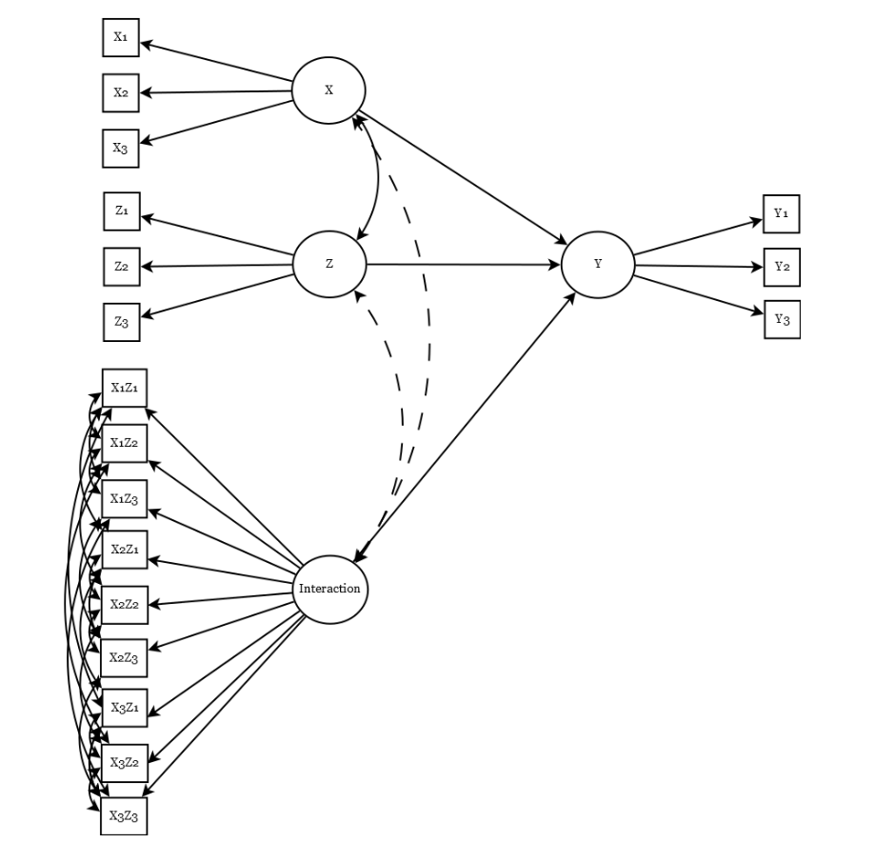
Latent Variable Interactions
The automatic creation of latent interactions has not yet been implemented in lavaan (like in Mplus).
You need to create a product term for each combination of indicators.
Excellent paper explaining process:
Schoemann, A. M., & Jorgensen, T. D. (2021). Testing and interpreting latent variable interactions using the semTools package. Psych, 3(3), 322-335.

Slide 44
Moderated Mediation in R

Slide 45
Moderated Mediation (& Mediated Moderation)
Moderated mediation, mediated moderation or conditional process analyses (coined by Hayes), are all terms used to describe a model that integrates both mediated and moderated pathways.
Moderator
Mediator
Predictor
Outcome

Slide 46
Model Diagram:
Statistical Diagram:
W*X
a3
W
a2
W
M
M
b1
a1
X
Y
X
Y
c’

Slide 47
Model Equations:
Y = b0 + b1M + c'X M = a0 + a1X + a2W + a3XW
Algebra to calculate conditional effects by writing model as Y = a + bX:
Y = b0 + b1M + c'X M = a0 + a1X + a2W + a3XW
Substituting in equation for M
Y = b0 + b1(a0 + a1X + a2W + a3XW) + c’X Multiplying out brackets
Y = b0 + a0b1 + a1b1X + a2b1W + a3b1XW + c’X
Grouping terms into form Y = a + bX
Y = (b0 + a0b1 + a2b1W) + (a1b1 + a3b1W + c')X
One indirect effect(s) of X on Y, conditional on W:
a1b1 + a3b1W
One direct effect of X on Y: c’
Index of moderated mediation: a3b1XW
W*X
a3
W
a2
M
b1
a1
X
Y
c’

Slide 48
Demo in lavaan
Does the indirect effect of social studies on science depend on maths ability?
Maths
Read
Social Studies
Science

Slide 49
Useful Resources
Main lavaan website: https://lavaan.ugent.be/
Book: Gana, K., & Broc, G. (2019). Structural equation modeling with lavaan. John Wiley & Sons.
Lavaan discussion forum: https://groups.google.com/g/lavaan

